Slide 1
Maritime Place
A Project Management Overview
PMI Emerald Coast Florida Chapter
January 21, 2014

Slide 2

Description of Project
Greenhut Construction Company
  Construction Manger at Risk
Contract Delivery
  Cost of Work plus Fee with a GMP
Phased Project Delivery
4-Story 75,739 sq ft Class A Office Building
Total Construction Cost: $12.5 Million
Maritime Place Workforce Inclusion Plan

Slide 3
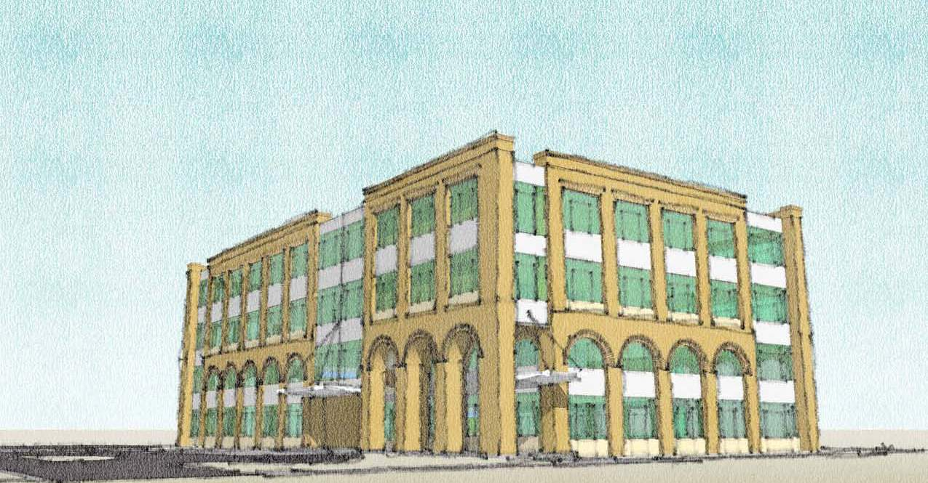
Description of Project

Slide 4
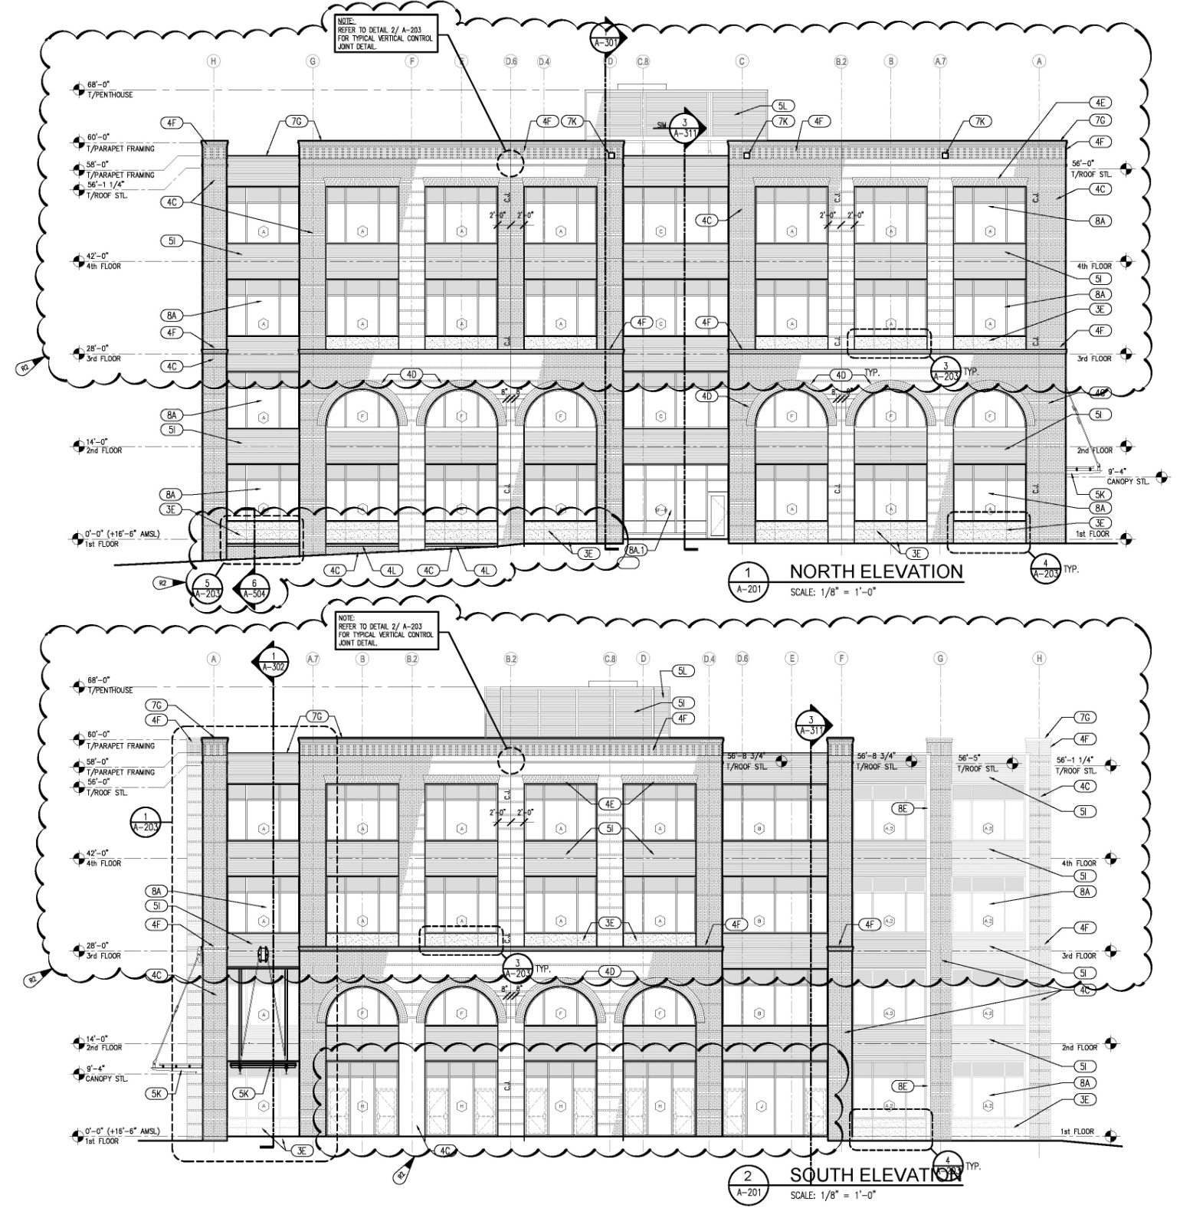
North Elevation
South Elevation

Slide 5
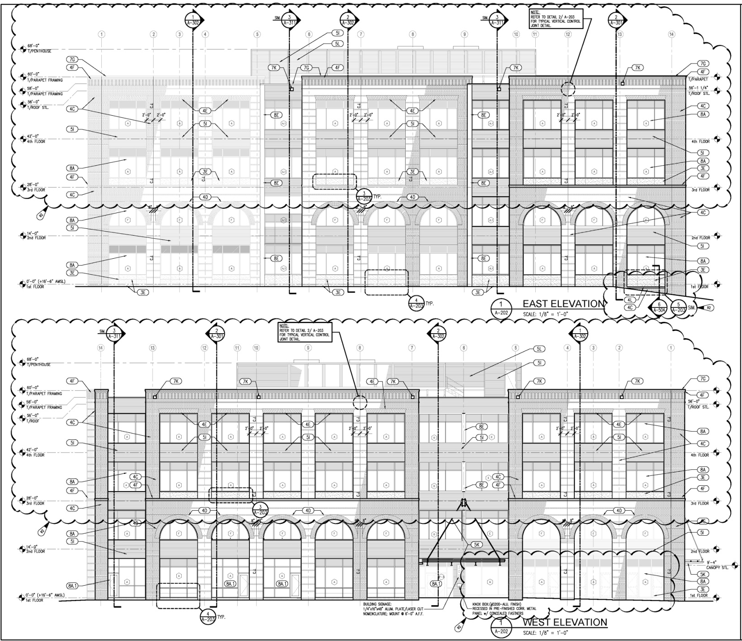
East Elevation
West Elevation

Slide 6
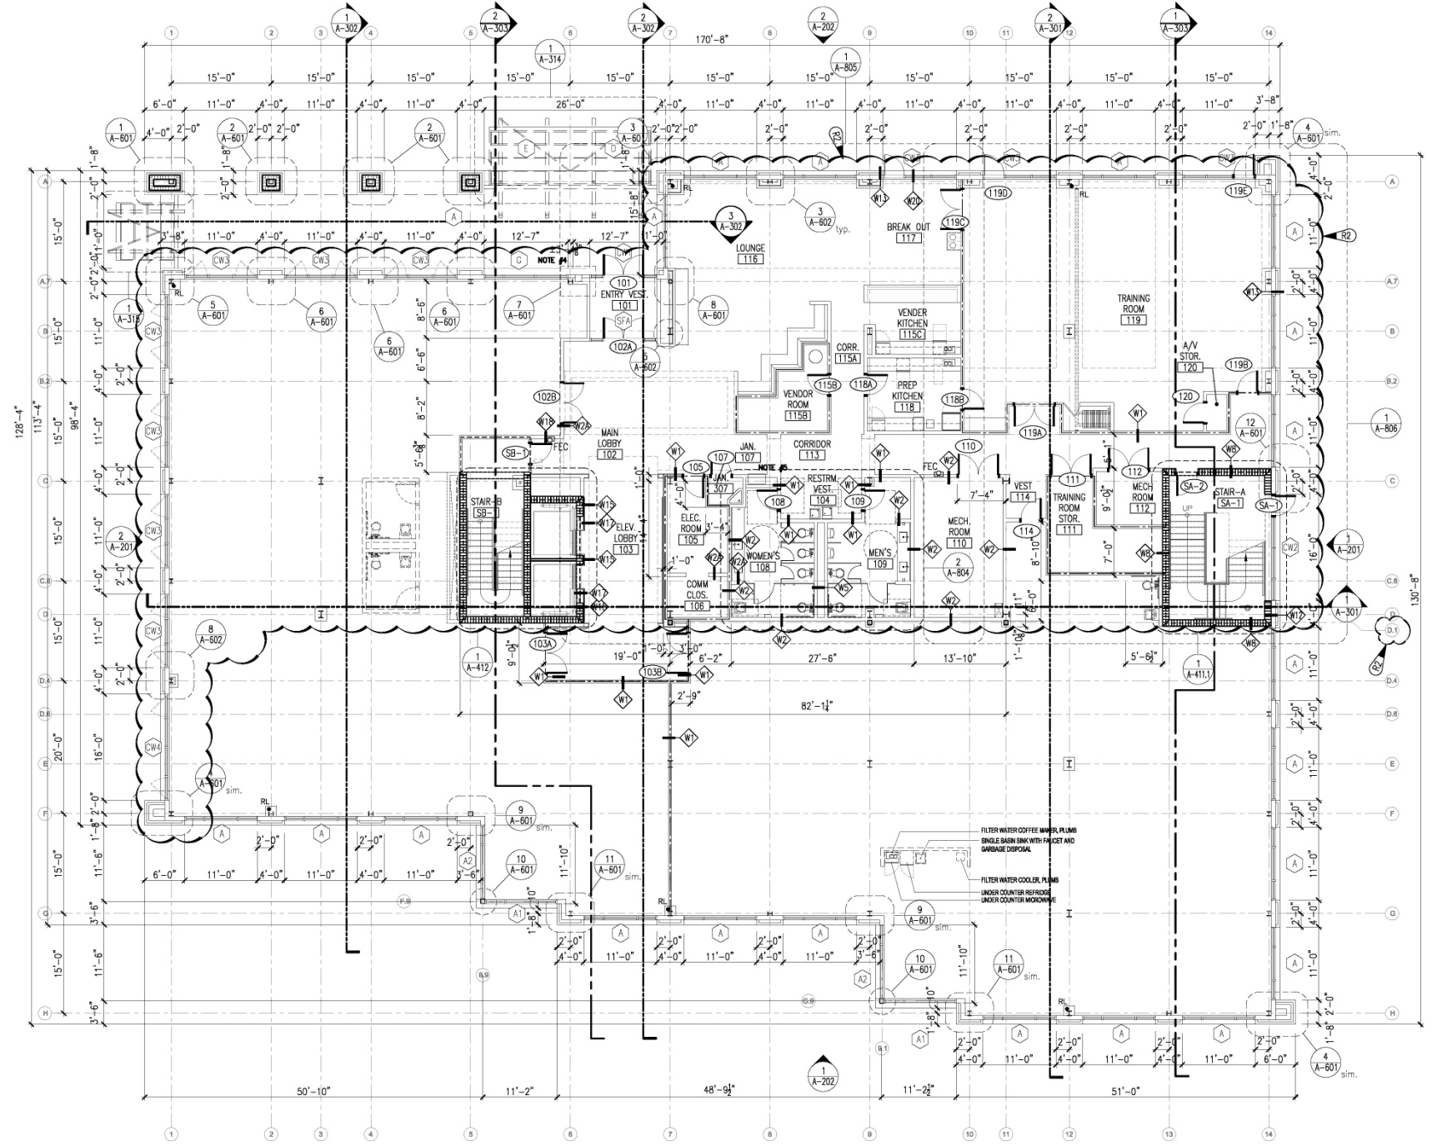
First Floor Core & Shell

Slide 7
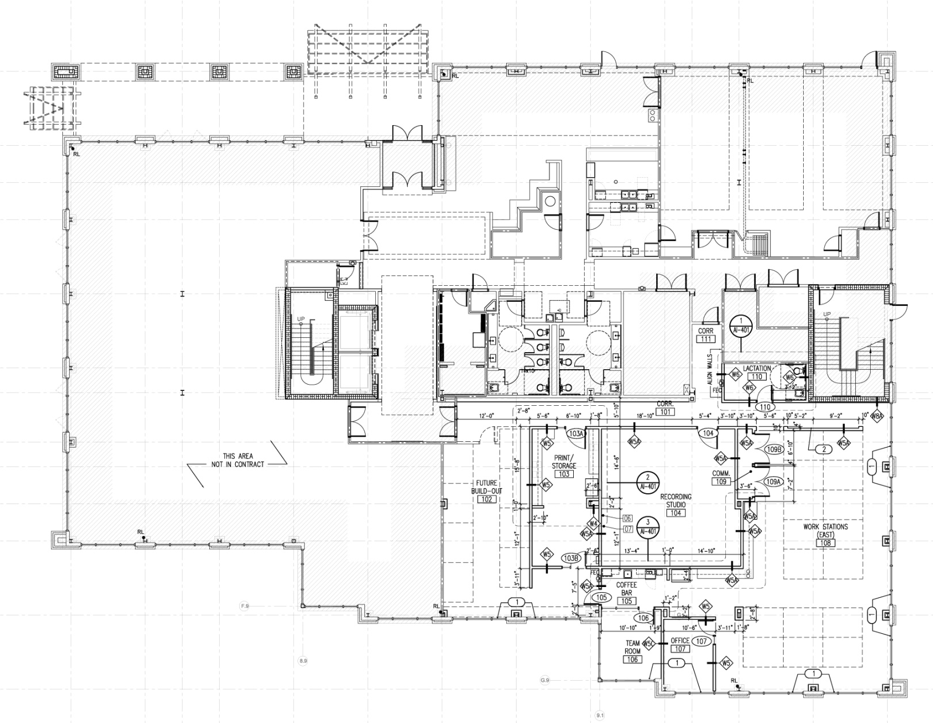
First Floor Plan – Studer Group

Slide 8
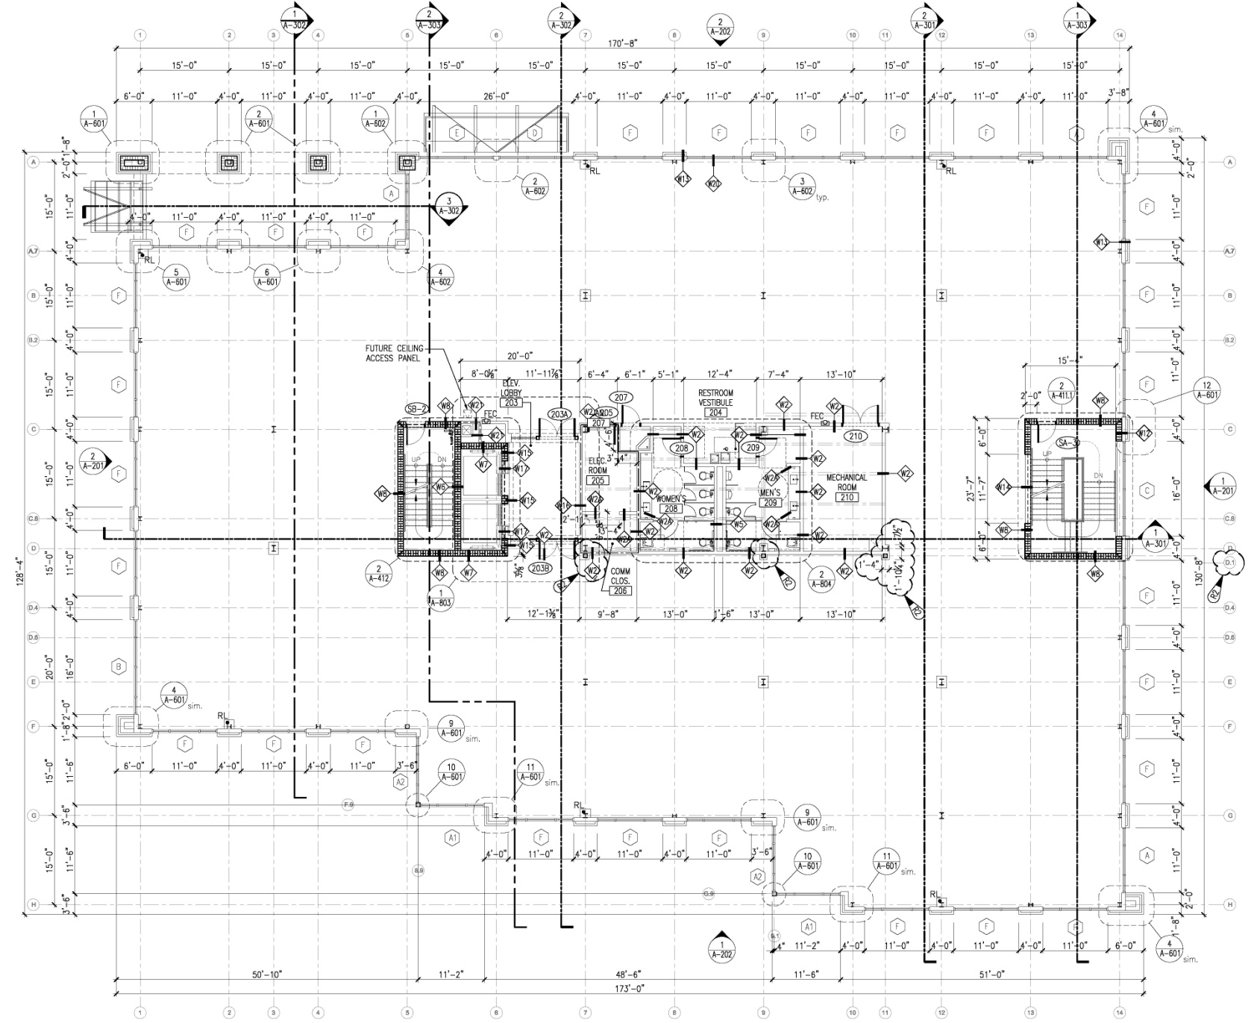
Second Floor Core & Shell

Slide 9
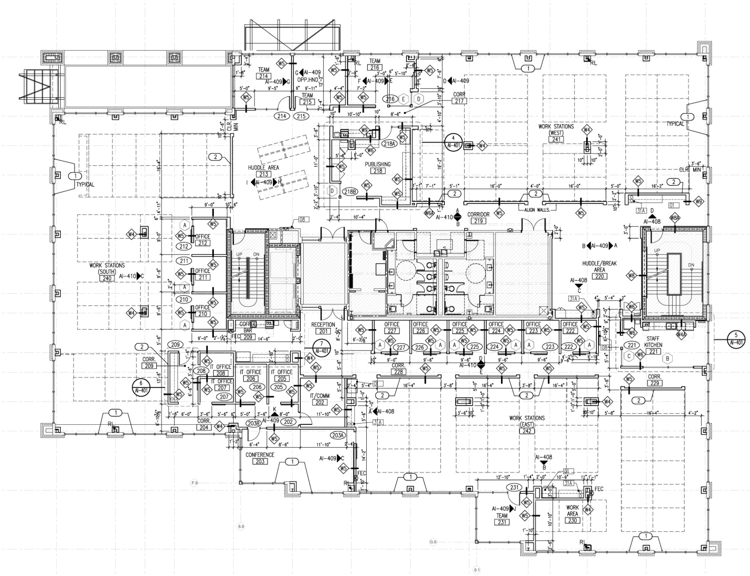
Second Floor Plan – Studer Group

Slide 10
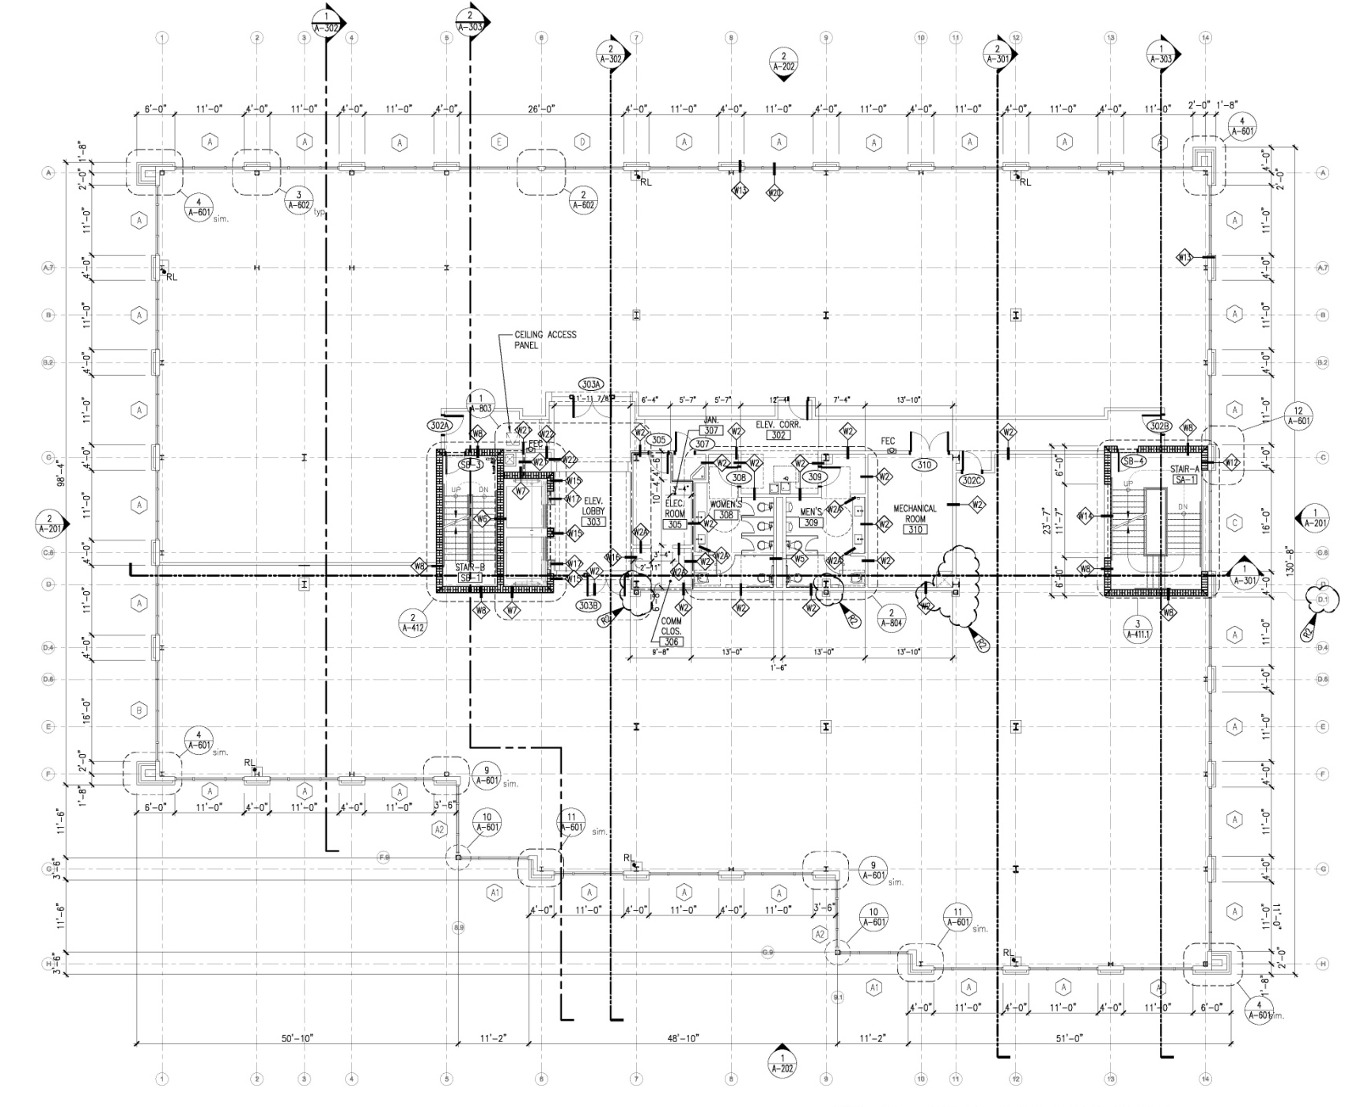
Third Floor Core & Shell

Slide 11
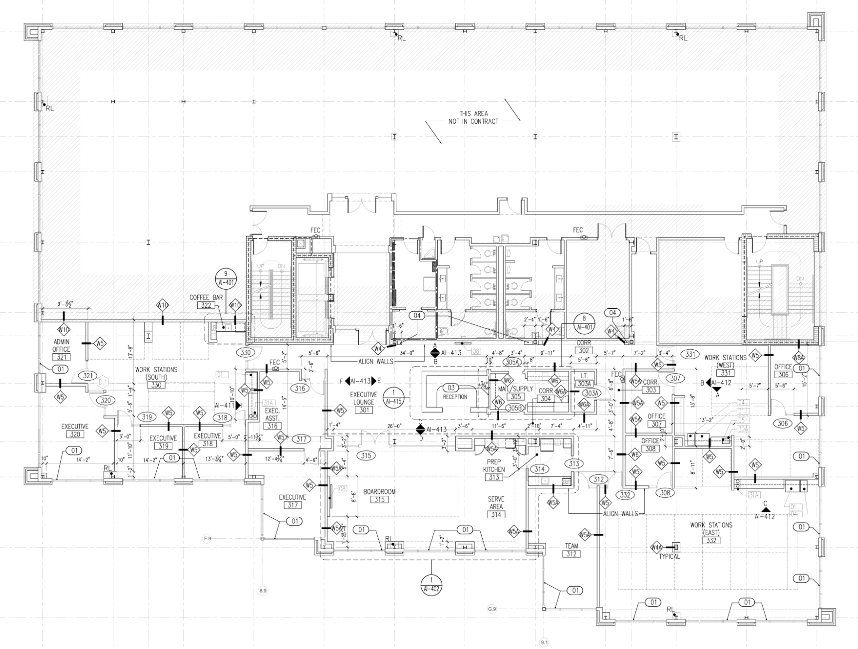
Third Floor Plan – Studer Group

Slide 12
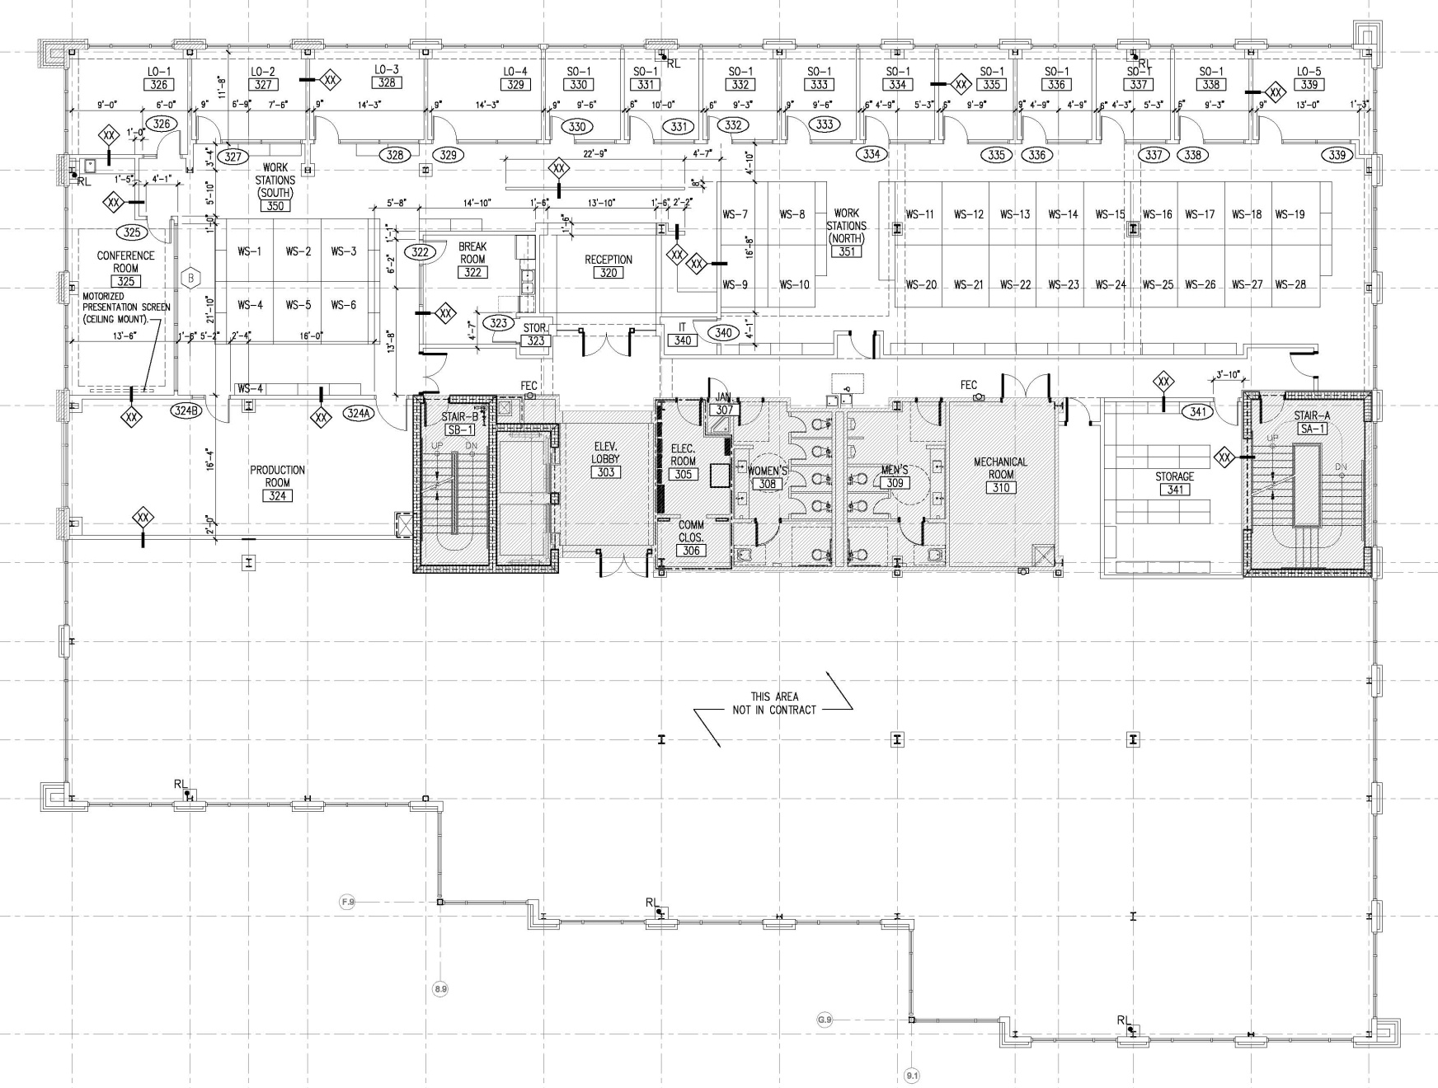
Third Floor Plan - EmCare

Slide 13
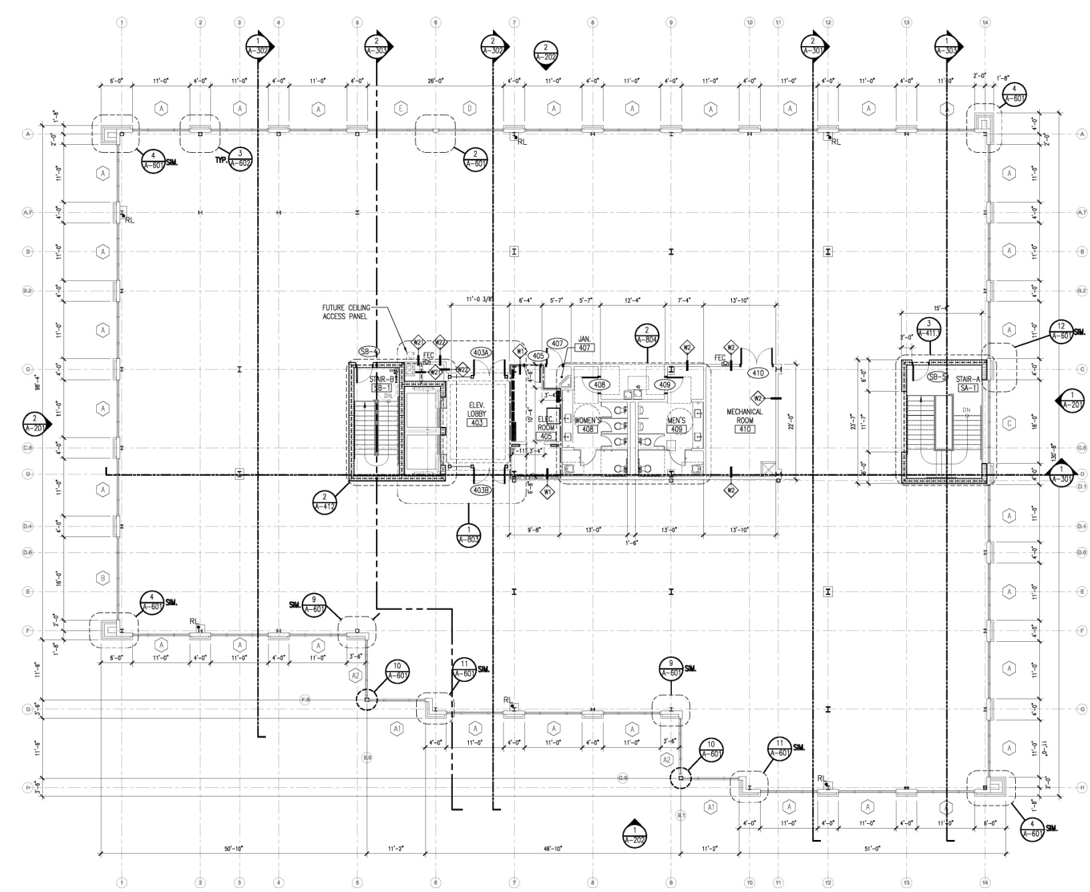
Fourth Floor Core & Shell

Slide 14
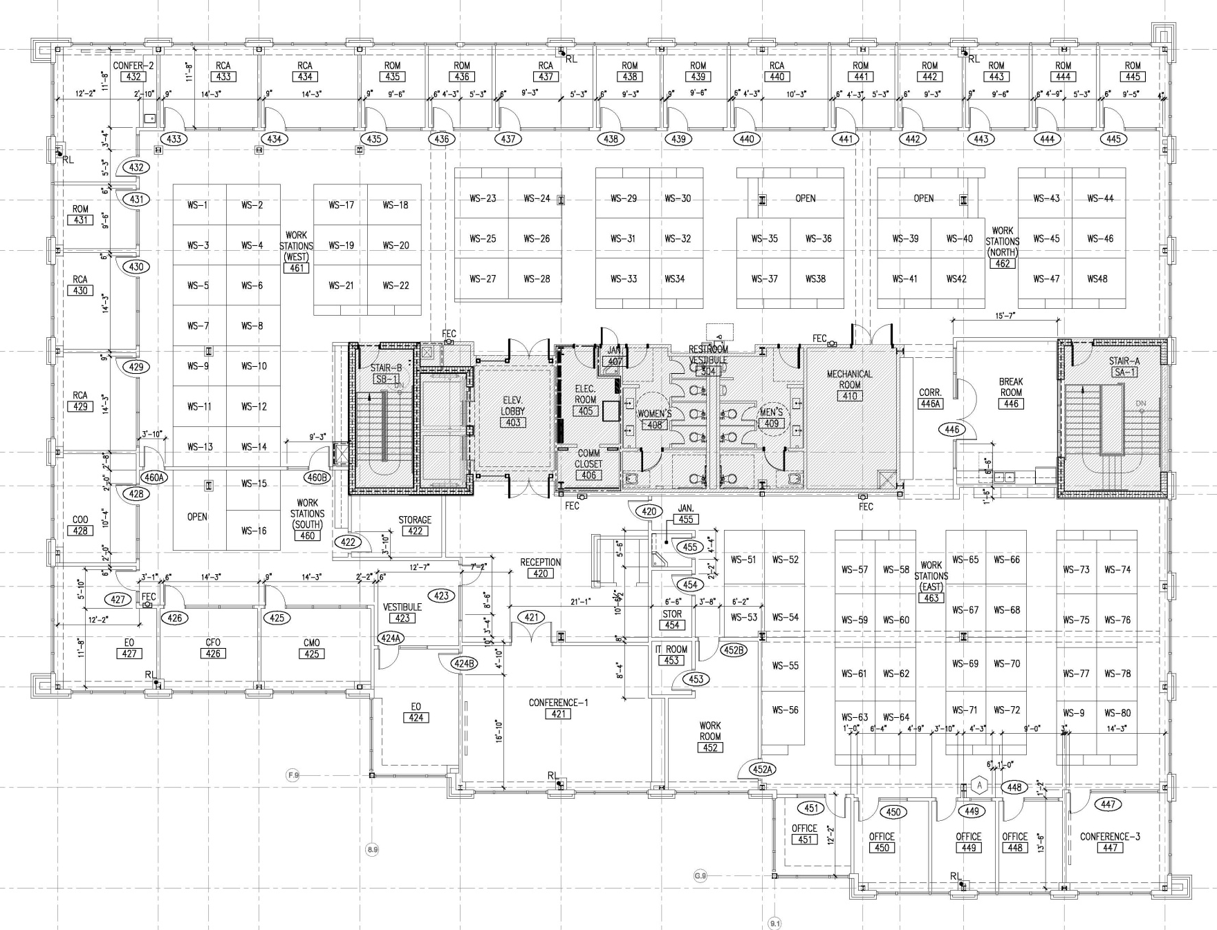
Fourth Floor Plan - EmCare

Slide 15
Project Team
Owner
  Maritime Place, LLC., a development of Studer Properties, LLP.
Program Managers
  The Dawson Company, Atlanta, GA
  Tessier Associates, Asheville, GA
Architect – SMP Architecture, Pensacola, FL
Structural Engineer – RAC Engineering, Gulf Breeze, FL
Mechanical Engineer – H.M. Yonge & Associates, Pensacola, FL
Electrical Engineer – BLV Electrical Engineers, Pensacola, FL
Construction Manager at Risk – Greenhut Construction Company, Pensacola, FL

Slide 16
Project Timeline / Schedule
Construction
Started June 10, 2013
Phase I – Site Foundation Structure
Phase II – Core and Shell
Scheduled for Completion August 28, 2014
Phase III – Tenant Buildouts
Scheduled for Completion October 24, 2014

Slide 17
Project Challenges
Fourth Floor added 4 Months into Construction
  Focus: Keep Project from Standstill
  Solution: Greenhut provided almost real time cost estimates & overall project schedule updates
    Allowed Owner to make educated decisions in contract negotiations
    Steered Design Team through contract document revisions & finalization
    Greenhut’s Prequalified Subcontractors & Suppliers were able to maintain internal cost control & continually provide value engineering suggestions

Slide 18
Project Challenges
Change in Funding
  Focus: Maintain Trust and Comfort Level among Owner, Program Mangers, Architect, Consultants, Contractor, and Subcontractors & Suppliers
  Solution: In lieu of terminating existing subcontracts and purchase order agreements, Greenhut was able to secure Final Lien Waivers prior to closing
    Facilitated a free and clear title at closing

Slide 19
Scope Control Strategies Implemented
While a bulk of Scope Control lies with the Design Team, Greenhut has implemented several key strategies to mitigate scope/cost creep.
  Close coordination/communication with Design Team / Owner
  Almost real time budget and OPS updates
  Very extensive market knowledge
  “Partnering” relationships with subcontractors & suppliers

Slide 20
Maritime Place Workforce Inclusion Plan
This plan describes the goals and processes for maximizing the utilization of Minority-Owned,
Woman-Owned, and Local Business Enterprises in, and the training and employment of local residents for the Maritime Place Office Building Development in Pensacola, Florida.
In demonstration of its commitment to this plan and the principles which it embodies, Greenhut Construction has engaged Mays Construction in a Mentor-Protégé and Consultant relationship.

Slide 21
Maritime Place Workforce Inclusion Plan
DBE Goal: 20% participation
WBE Goal: 5% participation
Local Resident Employment Goal: 50% of all on-site staff
Local Resident Hiring Goal: 100% of all newly hired staff
Target Local Residents are minority individuals who live
in the disadvantaged communities within the
Pensacola City Limits.

Slide 22
Questions and Comments
Maritime Place
A Project Management Overview
PMI Emerald Coast Florida Chapter
January 21, 2014

Slide 23
Thank You
Maritime Place
A Project Management Overview
PMI Emerald Coast Florida Chapter
January 21, 2014

